Slide 1

Government of Bermuda
Ministry of Education
October 24th 2016
2016 Year in Review
___
School Examination
Results

Slide 2

Blueprint for Reform in Education 2010 to 2016
Key Strategy
To provide:
    High-quality curriculum
    Effective delivery of curriculum
    Culturally relevant and engaging curriculum

Slide 3

Implementation of System Initiatives
(after 6 years of Cambridge Curriculum)
Middle School Transformation Plan
National Mathematics and National Literacy Strategies
MTSS, a multi-tier system support framework for academic and behaviour support
Priorities for Special Education and Inclusion
Teaching and Learning framework for Preschool, P1 and P2 teachers
Notes:
Change 4 to 5

Slide 4
System Improvement Statements
(what we continue to do)
The following statements are drivers for the successful implementation of the system initiatives:
Utilize a common framework for teaching mathematics and literacy
Improve the quality of teaching at every classroom level
Continuous application of the inquiry learning method
Widespread use of teaching through problem solving and standards based instruction and assessments
Establish a positive school climate and system support for student success

Slide 5
System Standards of Accountability
(How we will execute)
School Improvement Plans for all Preschools,
Primary and Middle Schools:
Pre-approved by Department of Education
Implemented by School Principal/Administrator
Align with the system initiatives and improvement statements
Execute over a 3-year period; September 2015 to June 2018
Schools will submit progress reports on improvements every February and October commencing 2016 to measure system success

Slide 6
2015/16 External Exam Results
(where we currently are)
Three sets of exam results:
    Cambridge Checkpoint P6
    Cambridge Checkpoint M3
    IGCSE/GCSE/AS/A Levels
Note: The IGCSE/GCSE/AS and A Level exams are administered by three different exam boards which are Cambridge, AQA and Edexcel.
Notes:
The IGCSE/GCSE/AS/A Levels are made up from 3 exam boards which are Cambridge, AQA and Edexcel

Slide 7
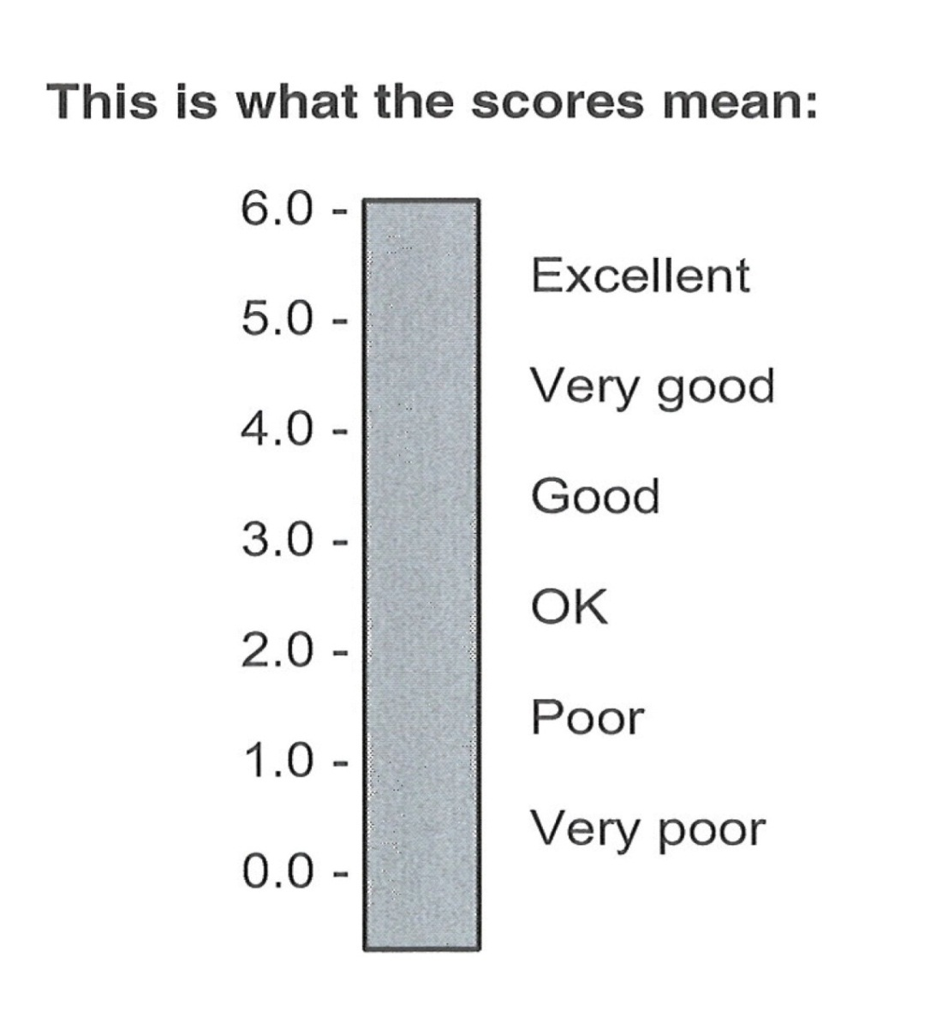
Cambridge Checkpoint Scale
Ministry of Education Expectation for 2016
A sound understanding of most of the curriculum content – 3.0
A basic understanding of curriculum content and would benefit from more focus on some areas of the curriculum – 2.0
Source: Cambridge International Examinations Board
Notes:
Cambridge Primary & Cambridge Secondary 1 Checkpoint scale.

Slide 8
Primary School Level 6 Results
Cambridge Primary 6 Checkpoint – Core Subjects
English
  83% of students scored at level 2.0 & above
  59% of students achieved 3.0 & above
Mathematics
  54% of students scored at level 2.0 & above
  30% students achieved 3.0 & above
Science
  86% of students scored at level 2.0 & above
  61% of students achieved 3.0 & above
Notes:
An overall system status of 51% at level 3 & above
An overall system status of 75% at level 2 & above

Slide 9
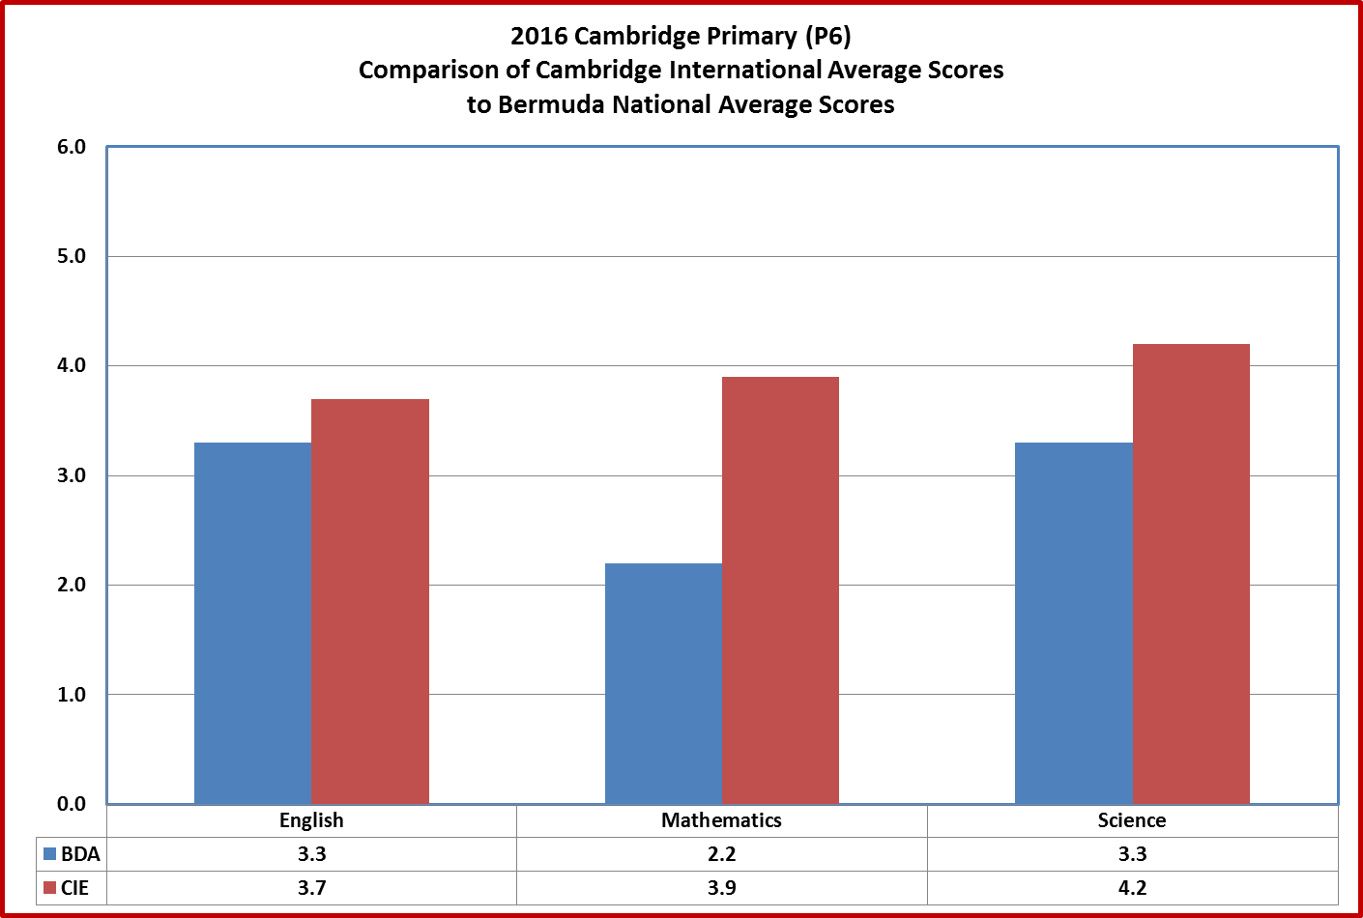
Notes:
Scores are very close to last years scores

Slide 10
Bermuda Public School System
Highlights – Middle Level (M3)
Cambridge Middle 3 Checkpoint – Core Subjects
English
  66% of students scored at level 2.0 & above
  35% of students achieved 3.0 & above
Mathematics
  49% of students scored at level 2.0 & above
  29% students achieved 3.0 & above
Science
  83% of students scored at level 2.0 & above
  44% of students achieved 3.0 & above
Notes:
3.0 represents a sound understanding of most of the curriculum content – Cambridge
2.0 represents a basic understanding of curriculum content and would benefit from more focus on some areas of the curriculum – Cambridge

Slide 12
Bermuda Public School System
Highlights – Senior Level
All External Examinations (A/AS/IGCSE/GCSE)
  1,310 exams taken by students
  1,067 exams graded A*- G; an 89% pass rate;
  402 exams graded A*- C; a 33% pass rate
  Middle School (IGCSE)
  68 exams sat by middle school students
  49 exams graded A*- G; a 76% pass rate
  36 exams graded A*- C; a 53% pass rate
Notes:
Scores in the A-C system range
8 - A*
35 – A
89 – B
270 – C

Slide 13
Government of Bermuda
Ministry of Education
October 24th 2016
2016 Year in Review
___
School Examination
Results

